Slide 1
Using Big Data Tools for Image Classification -
Final Report
Miles Franklin, Cliff Mbah

Slide 2
Project Goals
With the need of facemasks being a topic of debate in America, it has been difficult to slow the spread of Covid-19. The goal of this project is to build a database and a machine learning model to predict whether or not an individual is wearing a face mask. This would be a useful tool for businesses to have to help effectively regulate the behavior of citizens entering their buildings.

Slide 3
Project Implementations
Web scraping techniques
MongoDB management
Architecture design and pymongo API
Human collaboration
Creating a system to effectively check image labels
Machine learning algorithms
Decision Tree Classifier
Convolutional Neural Networks

Slide 4
Original Goals
Camera integration
Using a live feed to capture training images as well as performing predictions (real-time object detection)
Move code into a cluster environment (UMBC Azure Cluster for 603)
Greater computing power as opposed to a personal device
Expand the size of our database
Limited to what MongoDB offers in a free package, so saving in a cluster environment instead may have be an idea worth exploring

Slide 5
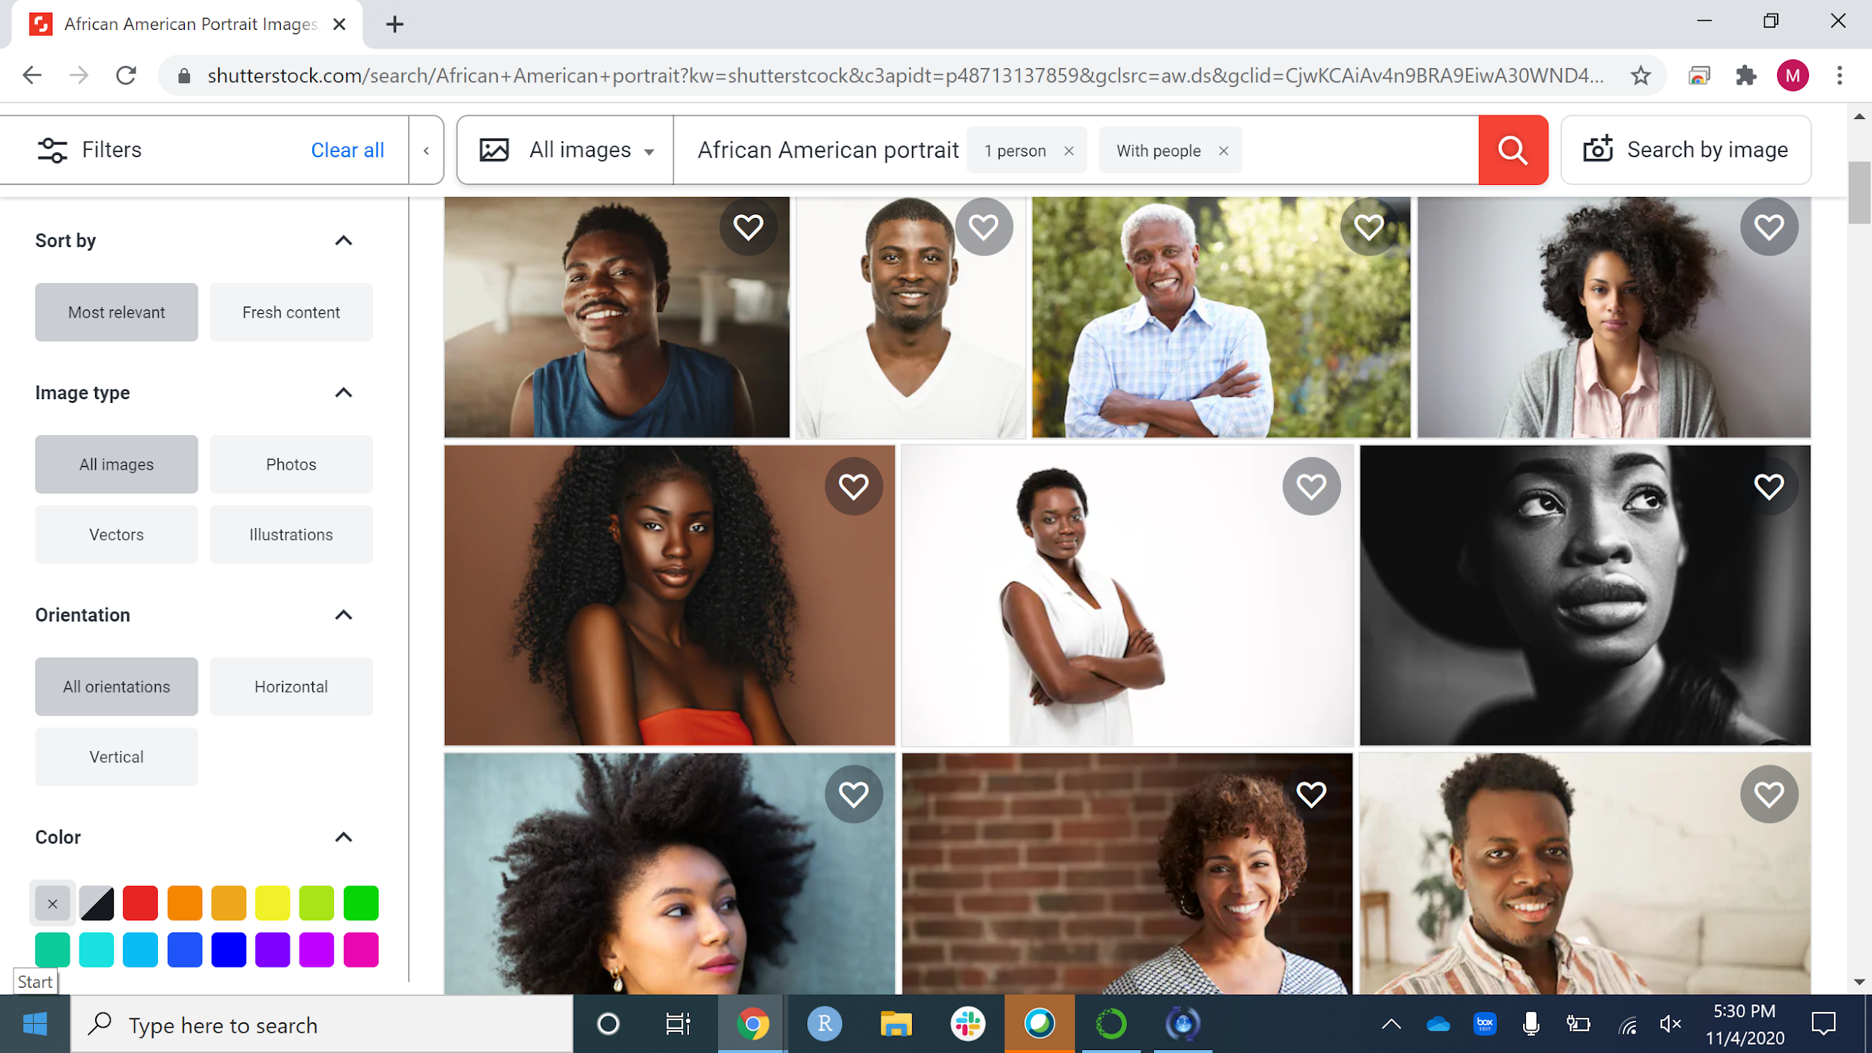
Web Scraping

Slide 6
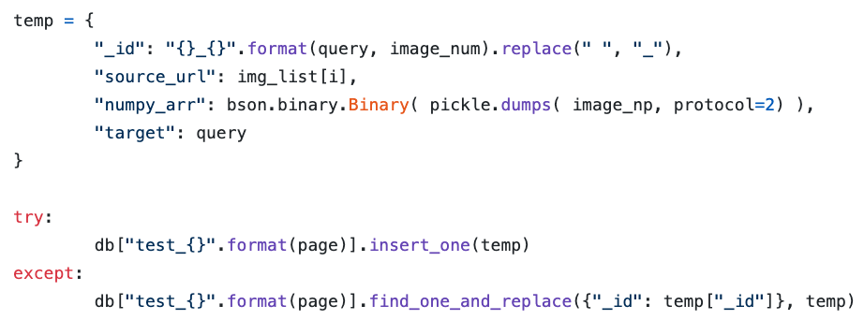
Data Formatting (Web Scraping)

Slide 7
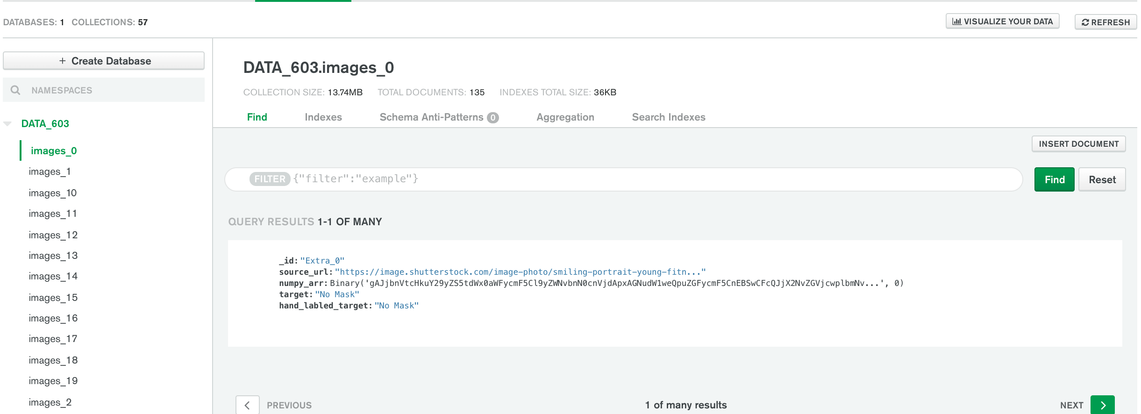
MongoDB Architecture

Slide 8
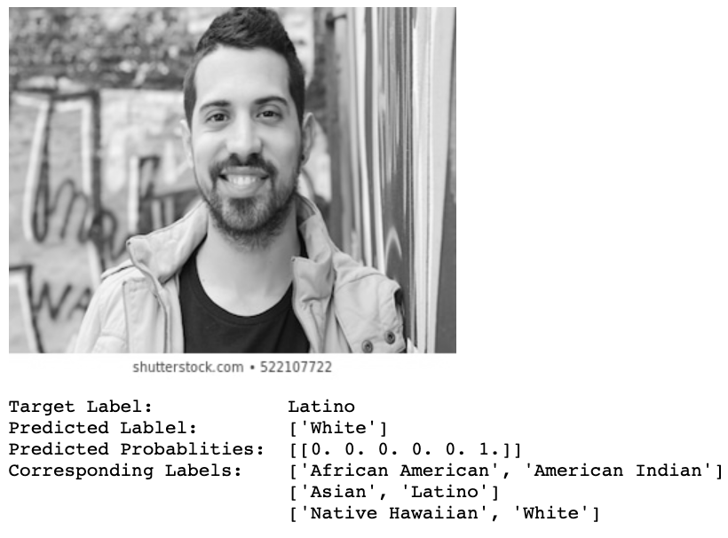
Decision Tree Classifier (Race)
Accuracy Scores
Training data: 99.3%
Testing data: 32.4%

Slide 9
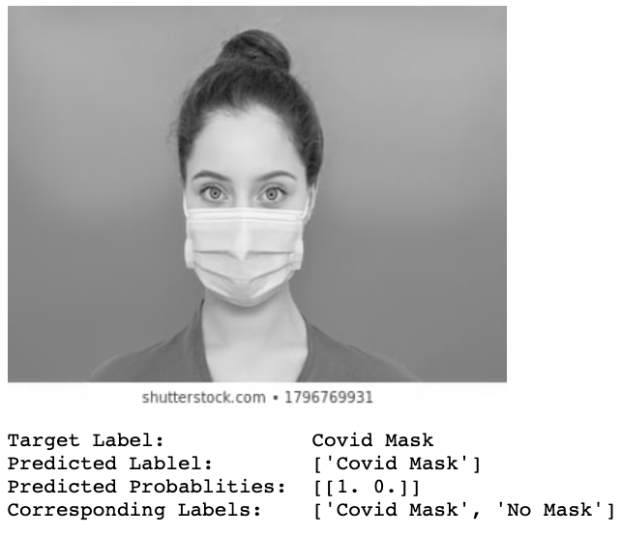
Decision Tree Classifier (Mask vs No Mask)
Previous Model Scores
Training data: 99.3%
Testing data: 32.4%
Current Model Scores
Training data: 100%
Testing data: 77.6%
This implies a bit of overfitting
Overall great start for a binary model
Will also implement a grid cross validation

Slide 10
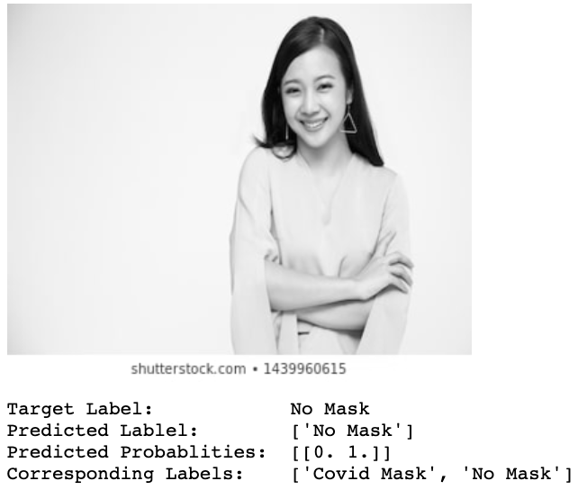
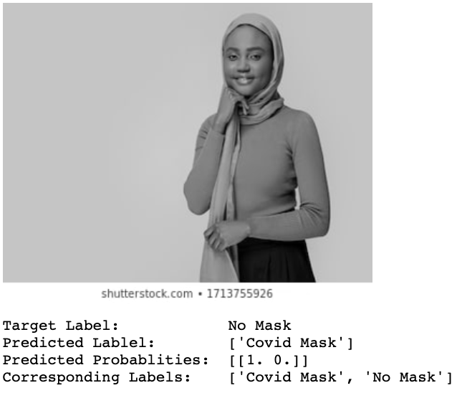
Additional Examples

Slide 11
Machine Learning:
Convolutional Neural Network

Slide 12
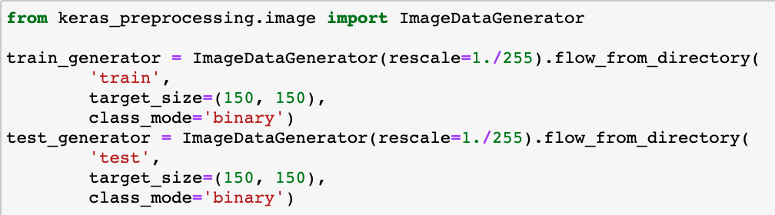
Image Formatting
Tensor Flow is very particular with image formatting
This required us to download database to our local drive in a folder system
CNN_Images
Test
Mask
No_Mask
Train
Mask
No_Mask

Slide 13
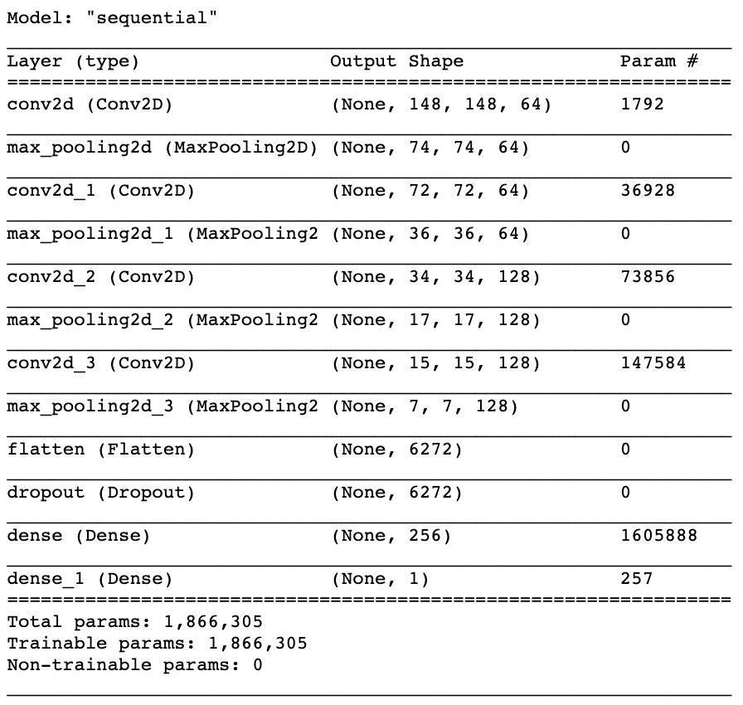
CNN Architecture
Built off of the model used in TensorFlow’s Tutorial for CNN
Made minor adjustments in design to accommodate a binary classification model
The number of nodes in the output layer from 3 to 1
The activation function for the output layer from softmax to sigmoid
The loss function was changed from categorical_crossentropy to binary_crossentropy
Note: This approach did not require us to grayscale or flatten the image array, thus, preserving the locality of images

Slide 14
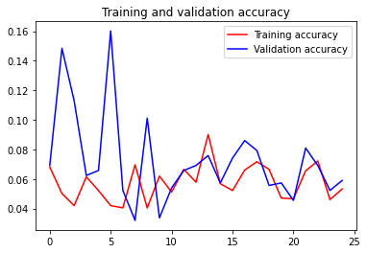
CNN
Decision Tree Classifier
Training data: 100%
Testing data: 77.6%
Current Model
Training data: 7.2%
Testing data: 7.3%

Slide 15
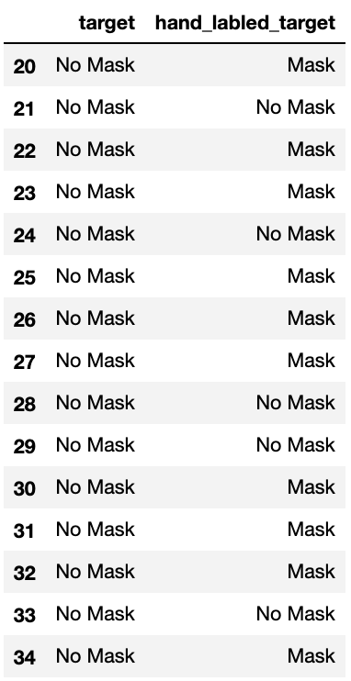
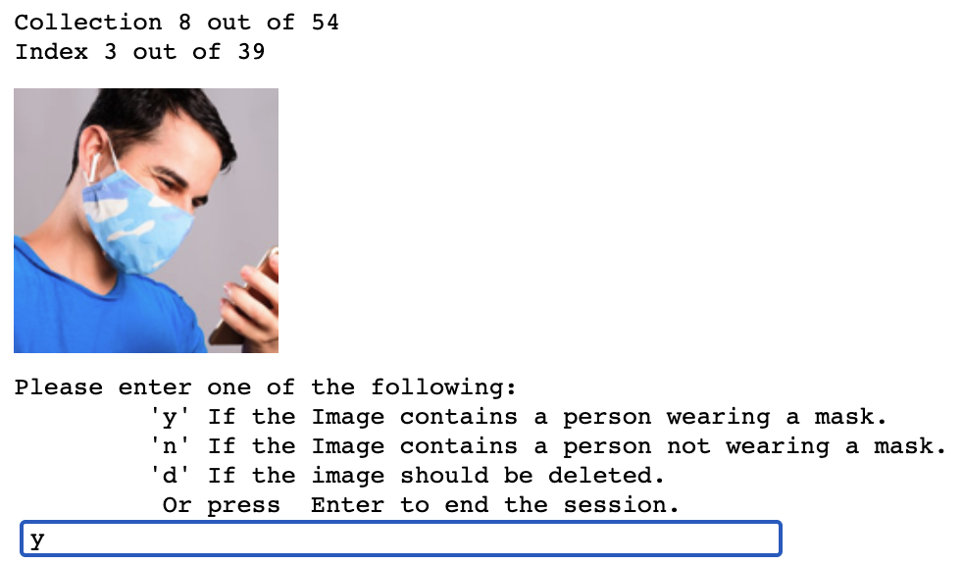
Human Collaboration

Slide 16
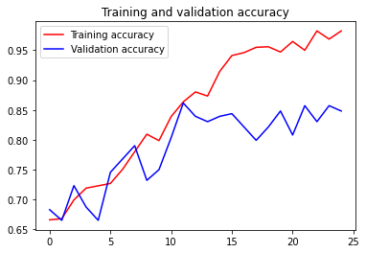
CNN After Human Collaboration
CNN Before
Training data: 7.2%
Testing data: 7.3%
Wall time: 1hr 8min 35s
CNN After
Training data: 98.2%
Testing data: 83.4%
Wall time: 49min 28s
Note
This is on a smaller dataset of only 1242 images.
Total database size is 2546 images
This model would benefit from a larger dataset of similar quality

Slide 17
Conclusion
We were able to successfully create a database and a selection of machine learning models to choose from. While our winning model certainly has a long way to go, this has been a great experience and has introduced us to the field of neural networks and computer vision.
We learned database design and management
First hand experience with Convolutional Neural Networks
Learning the different layers that can be added to a network
The many ways to store image data for training machine learning models
We learned that hardware can easily become a limiting factor in project development
Storage, RAM, home wifi and bandwidth

Slide 18
Future Directions
Move Notebooks into Google Collab to make use of servers with available GPU’s
GPU’s are designed to process image data and can greatly improve runtime
This is also a wise option if your local machine is low on available storage space
Import larger datasets to train on
12,000 image dataset of faces with and without masks (Kaggle)
5,00 image dataset of faces without masks (Kaggle)
Transfer Learning: Find a similar project to build on top of rather than building from scratch
Learn to use real time camera feed for model deployment (TensorFlow Object Detection API)
Improve upon web scraping techniques
Google Images
Image limit per page
Webdrivers (Selenium)
Need a better understanding of Neural Network layers, so that we can design a meaningful architecture of our own

Slide 19
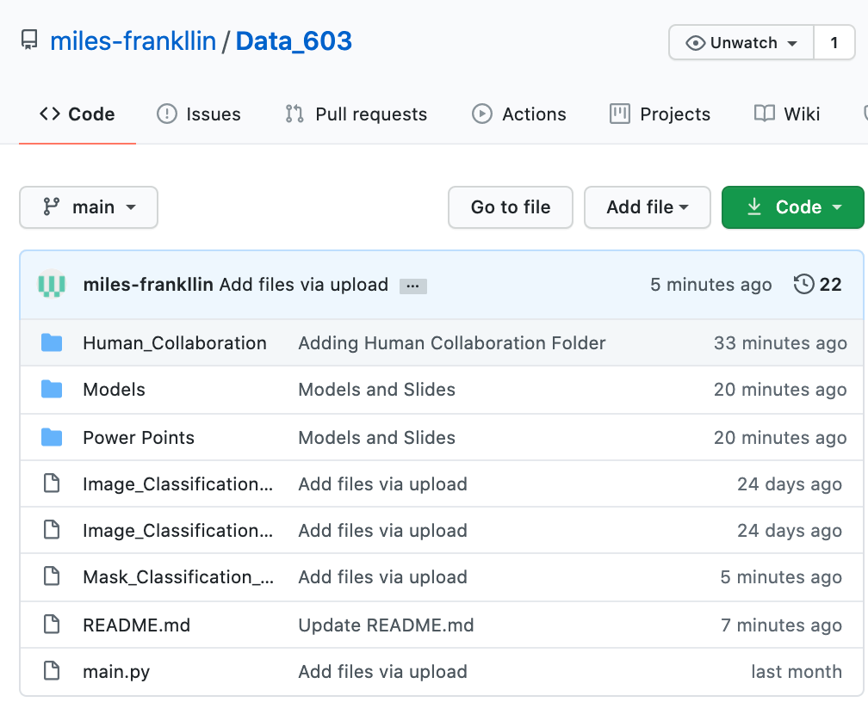
Evidence of Progress
Github Repository (Public)
Human Collaboration
User Interface for hand labeling images
Models
.h5 files of the trained models
Image_Classification_Sklearn_Race.ipynb
Image_Classification_Sklearn_Mask.ipynb
Mask_Classification_CNN.ipynb
Final Convolutional Neural Network model
main.py
Web scraper that writes into MongoDB

Slide 20

Questions
Notes:
Image Source: https://www.machinedesign.com/community/article/21836908/what-questions-should-you-ask-during-the-product-lifecycle

